Slide 1
CSE428: Image Processing
Lecture 2: HVS, Image Sensing and Digitization

Slide 2
Outline
Human Visual System (HVS)
Image Sensing
Sampling and Quantization
Digital Image Representation

Slide 3
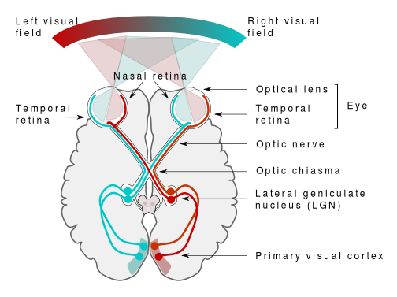
Human Visual System (HVS)
Visual perception - key role in image processing
Eye - sensor of the HVS
Brain - image processing
Integrates intelligence and experience with input
By Miquel Perello Nieto - Own work, CC BY-SA 4.0, https://commons.wikimedia.org/w/index.php?curid=37868501

Slide 4
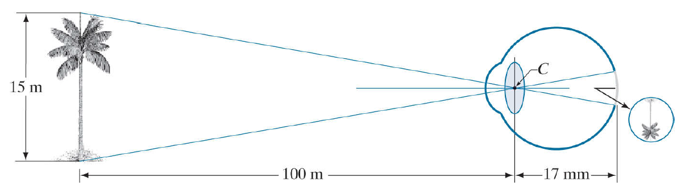
Human Visual System (HVS)
Image formation in human eye
By Rafael C. Gonzalez & Richard E. Woods, 2018, Digital Image Processing, 4th Edition
h/17 mm = 15 m / 100 m

Slide 5
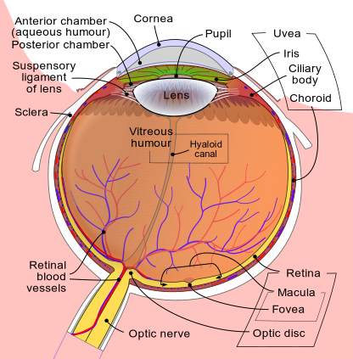
Human Visual System (HVS)
Structure of the eye
By Rhcastilhos. And Jmarchn. - Schematic_diagram_of_the_human_eye_with_English_annotations.svg, CC BY-SA 3.0, https://commons.wikimedia.org/w/index.php?curid=1597930

Slide 6
Human Visual System (HVS)
Structure of the eye
Iris & Pupil - Controls the amount of light
Ciliary Body - adjusts the focal length of optical lens
Retina - Receptors (sensors) of 2 types, cones and rods
Fovea - focusing region
By Rhcastilhos. And Jmarchn. - Schematic_diagram_of_the_human_eye_with_English_annotations.svg, CC BY-SA 3.0, https://commons.wikimedia.org/w/index.php?curid=1597930

Slide 7
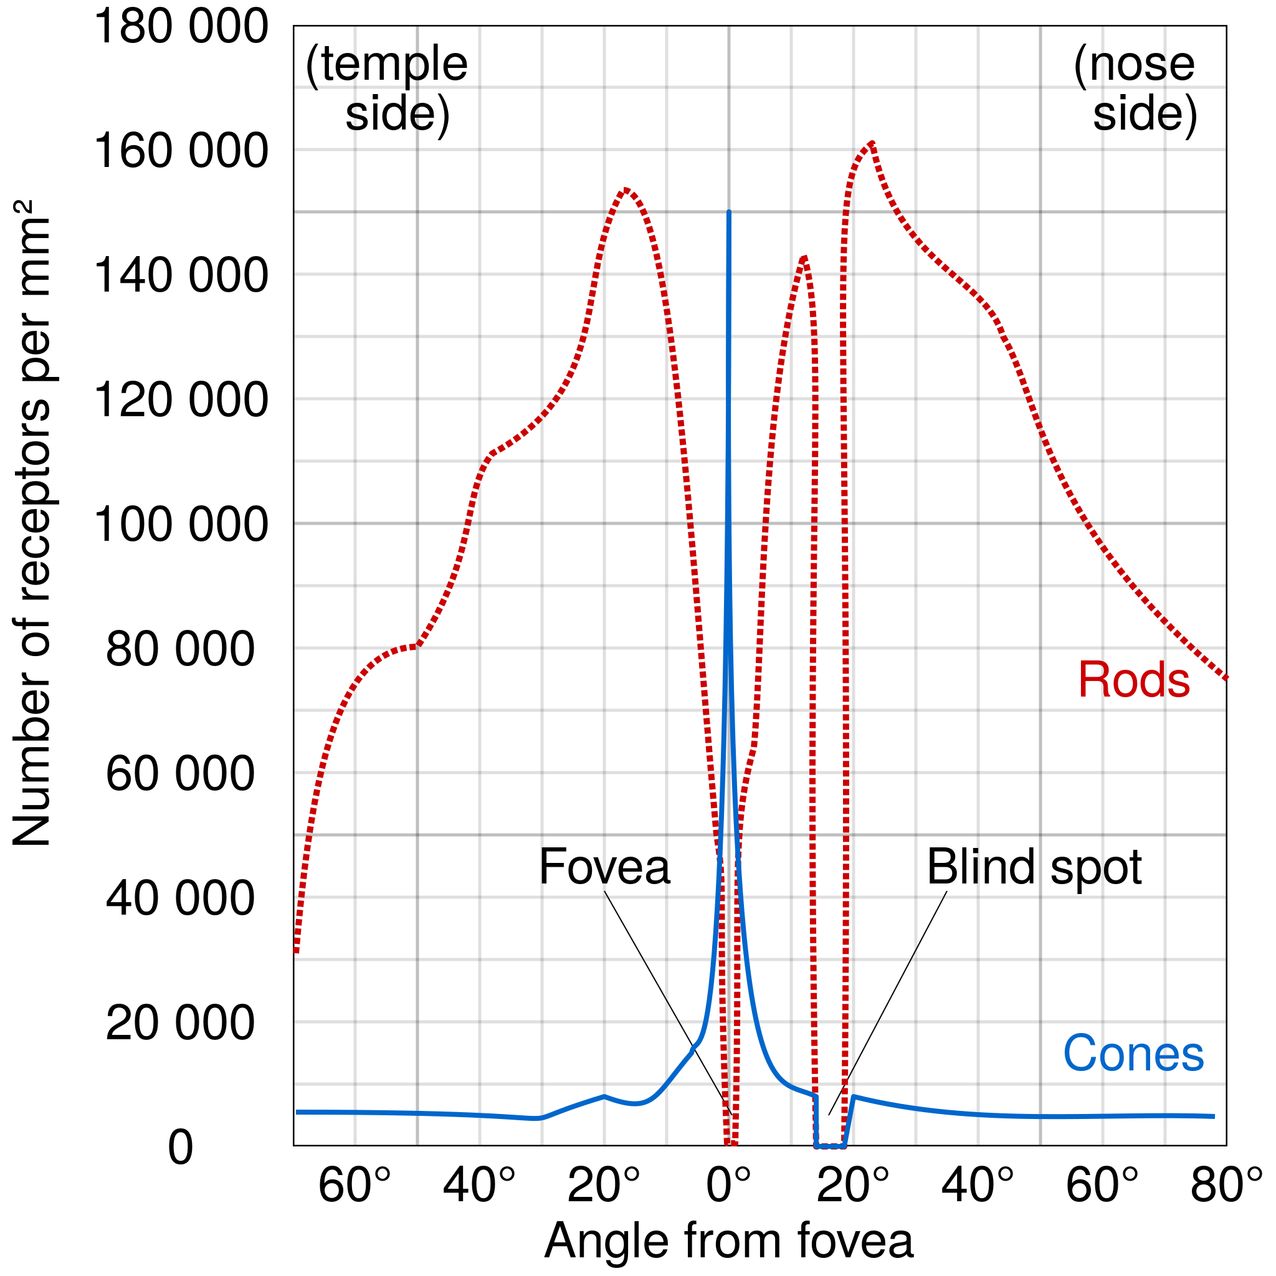
Human Visual System (HVS)
Cones and Rods
Cones - Low in number. Concentrated on a central position called fovea. Highly sensitive to color. Fine details response since each cone connected with a nerve.
Rods - High in number. Distributed over the optic globe. Sensitive to low light vision with no color information. Low resolution response since several rods connected with a nerve.
By Cmglee - Own work, CC BY-SA 3.0, https://commons.wikimedia.org/w/index.php?curid=29924570

Slide 8
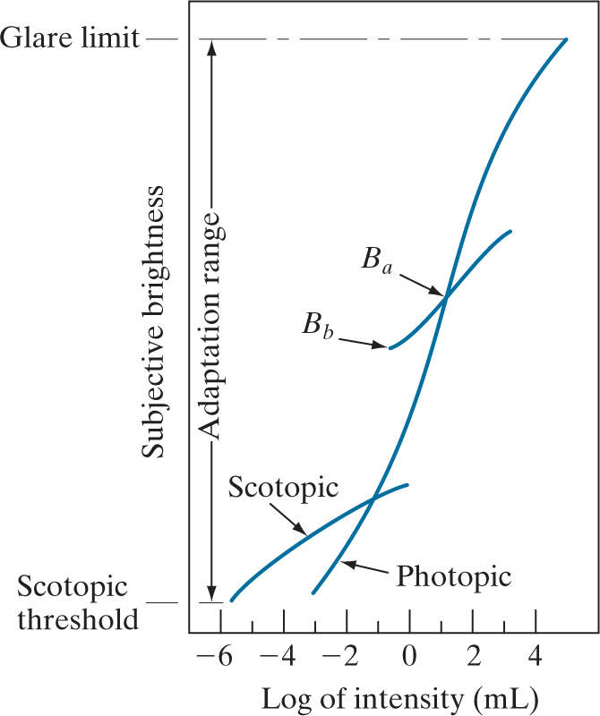
Human Visual System (HVS)
Brightness Adaptation
Camera captures intensity, objective
We perceive brightness, subjective
Subjective brightness is a logarithmic function of light intensity
Adaptation range for photopic vision is quite high, but overall adaptation due to scotopic vision is quite low.
Thus, for a given set of brightness (say Ba) condition, the range of discriminative intensity level of HVS is rather small (shown as curve of Ba-Bb).
By Rafael C. Gonzalez & Richard E. Woods, 2018, Digital Image Processing, 4th Edition

Slide 9
Human Visual System (HVS)
Brightness Discrimination
I = background intensity
ΔI = change in intensity required for “just noticeable difference”
Weber ratio = ΔI/I
A smaller Weber ratio → only a small intensity change is distinguishable (good brightness discrimination)
I + ΔI
I

Slide 10
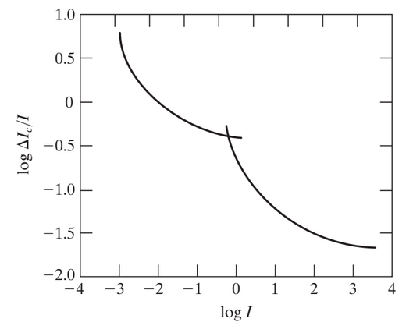
Human Visual System (HVS)
Brightness Discrimination
Weber ratio as a function of intensity
The power of brightness discrimination increases with the background intensity level
Need “contrast stretching” for poorly illuminated images (Week 2)
By Rafael C. Gonzalez & Richard E. Woods, 2018, Digital Image Processing, 4th Edition

Slide 11


Human Visual System (HVS)
Brightness Discrimination
0 | 0 | 0
0 | 10 | 0
0 | 0 | 0
255 | 255 | 255
255 | 245 | 255
255 | 255 | 255
ΔI = 10
I = 0
I = 255

Slide 12
Human Visual System (HVS)
Brightness Discrimination

Slide 13

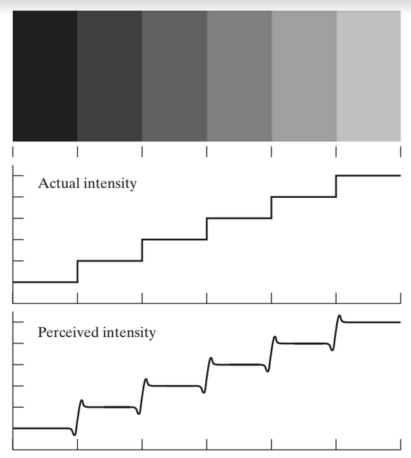
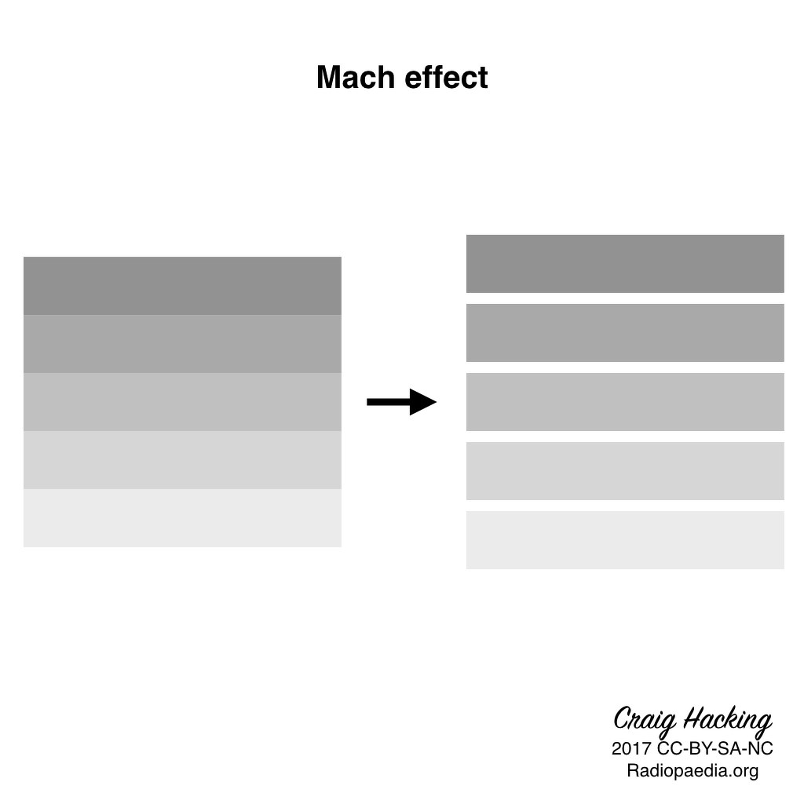
Human Visual System (HVS)
Brightness Discrimination (Mach bands)
By The original uploader was Aliwiki at French Wikipedia. - Transferred from fr.wikipedia to Commons by Korrigan using CommonsHelper., FAL, https://commons.wikimedia.org/w/index.php?curid=4770182
By Rafael C. Gonzalez & Richard E. Woods, 2018, Digital Image Processing, 4th Edition

Slide 14
Human Visual System (HVS)
Optical Illusion Due to Perceived Brightness
Identify the middle-box with the highest intensity

Slide 15
Human Visual System (HVS)
Optical Illusion Due to Perceived Brightness
They have the same intensity!

Slide 16
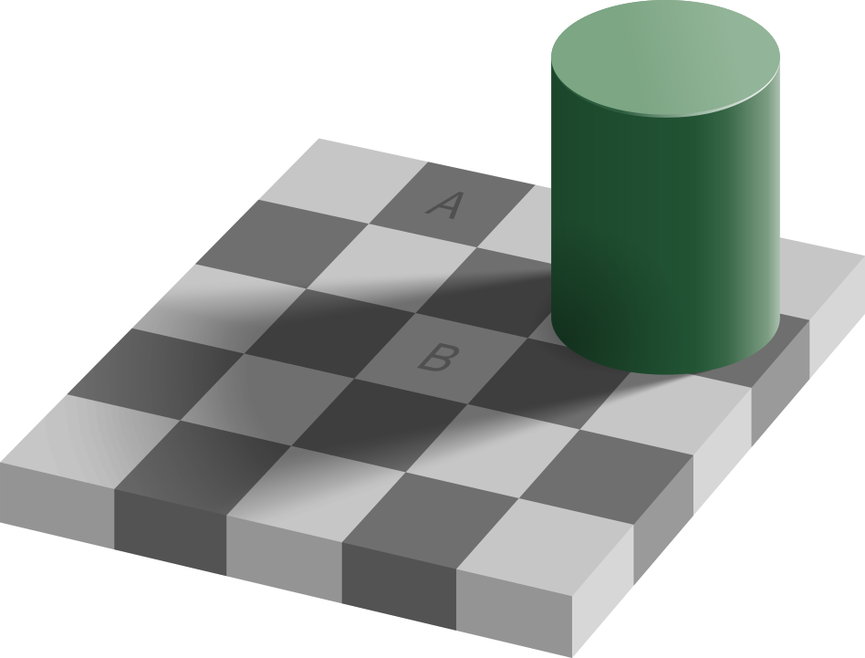
Human Visual System (HVS)
Optical Illusion Due to Experience
Which one has more intensity, A or B?
By Original: Edward H. Adelson, vectorized by Pbroks13. - Own work, CC BY-SA 4.0, https://commons.wikimedia.org/w/index.php?curid=75000950

Slide 17

Human Visual System (HVS)
Optical Illusion Due to Experience
They have the exact same intensity!
By Original: Edward H. Adelson, vectorized by Pbroks13. - Own work, CC BY-SA 4.0, https://commons.wikimedia.org/w/index.php?curid=75000950

Slide 18
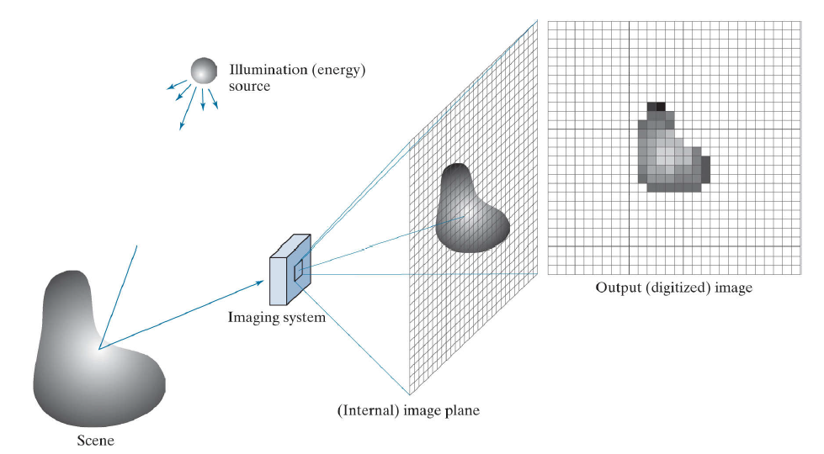
Digital Image Acquisition
Example pipeline of digital image acquisition using a camera with CCD sensor array
Image Formation
Sensing
Digitization
Representation
By Rafael C. Gonzalez & Richard E. Woods, 2018, Digital Image Processing, 4th Edition

Slide 19
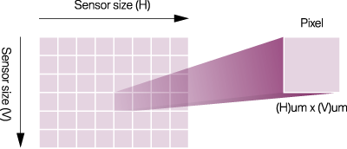
Image Sensing
Sensor size and Pixel size
Sensor size is the size of the sensor inside a camera
Pixel size is the size of the individual image sensor that compose image sensor
Example:
Sensor size＝ 7.04mm x 5.28mm
Effective Pixel amount : 1600 x 1200
Pixel size = 4.4μm x 4.4μm (verify)
Total Pixel count = 1600 x 1200 = 1,920,000 = 1.92 x 10⁶ = 1.92 M (also called 1.9 Megapixels)
By Rafael C. Gonzalez & Richard E. Woods, 2018, Digital Image Processing, 4th Edition

Slide 20
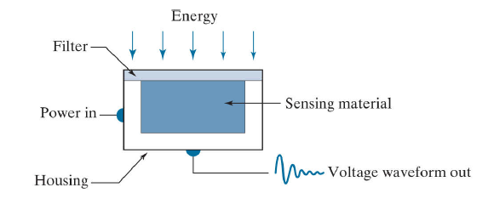
Image Sensing
Single Sensing Element (Sensor)
A typical CCD camera has 4000×4000 sensors in array
Electrical response to each sensor ∝ Integral of light intensity on surface over time, and thus reducing noise
Electrical signal is stored in digitized form as a digital image
By Rafael C. Gonzalez & Richard E. Woods, 2018, Digital Image Processing, 4th Edition

Slide 21
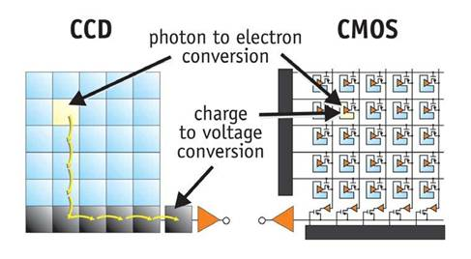
Image Sensing
Types of Image Sensors

Slide 22
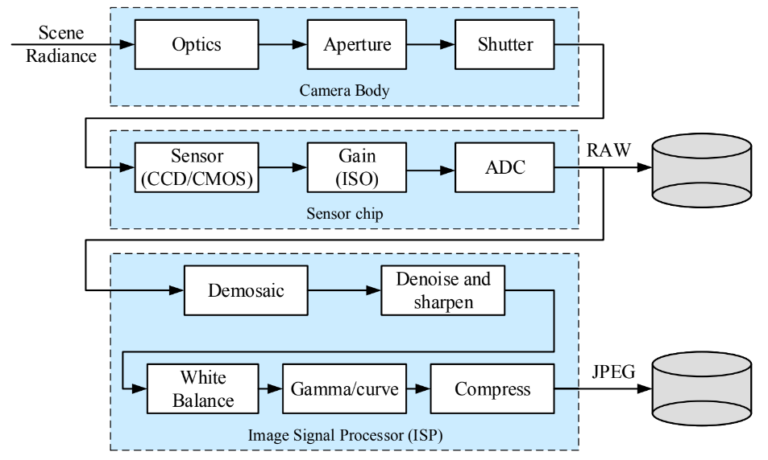
Image Sensing Pipeline
Example pipeline of digital image acquisition using a camera with CCD sensor array
Image Formation
Sensing
Digitization
Representation

Slide 23


Image Sensing
Sensor Array
Copyright © Baumer 2021, Animation-Global-vs-Rolling-Shutter-200317-EN-IT.gif, Baumer Passion for Sensors, https://www.baumer.com/us/en/service-support/function-principle/function-principle-and-applications-of-rolling-shutter-cmos-cameras/a/CMOS-rolling-shutter-cameras
By Rafael C. Gonzalez & Richard E. Woods, 2018, Digital Image Processing, 4th Edition
Line and grid Array of sensors
Exposure method - Rolling shutter vs global shutter

Slide 24
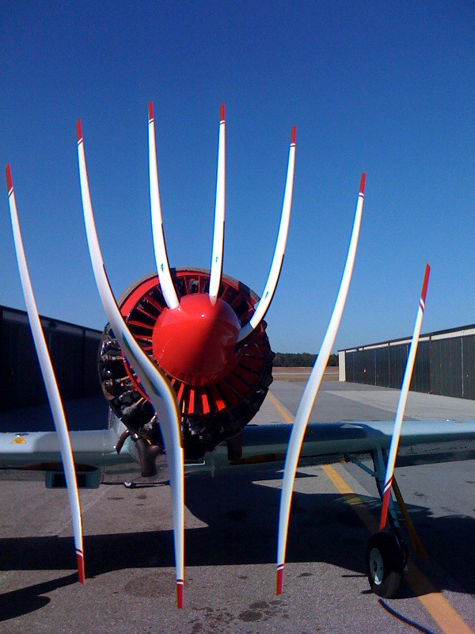
Image Sensing
Rolling Shutter Effect
Number of blades? (Assuming the scan direction is from left to right)
Direction of rotation?
Speed of rotation? (RPM)
Ragsdale, S. 2009. “Airplane Prop + CMOS Rolling Shutter = WTF”. Online Image. <https://www.flickr.com/photos/sorenragsdale/3192314056/in/photostream/>

Slide 25
Image Sensing
Rolling Shutter Effect
Cole, J. 2014. “Rolling Shutters”. Online Image. <https://jasmcole.com/2014/10/12/rolling-shutters/>
Ragsdale, S. 2009. “Airplane Prop + CMOS Rolling Shutter = WTF”. Online Image. <https://www.flickr.com/photos/sorenragsdale/3192314056/in/photostream/>

Slide 26
Digital Image Acquisition
Image Formation Model
The captured intensity 0 ≤ f(x, y) < ∞
f(x, y) = i(x, y) r(x, y)
Illumination, 0 ≤ i(x, y) < ∞
Reflectance, 0 ≤ r(x, y) ≤ 1
L_{min} ≤ f(x, y) ≤ L_{max}; where:
L_{max} : Maximum detectable light energy
L_{min} : Minimum detectable light energy
The quantity 20*log₁₀(L_{max} / L_{min}) is called the dynamic range
The interval [L_{min}, L_{max}] is called gray scale
Typical indoor values: L_{min}≈10, L_{max}≈1000

Slide 27
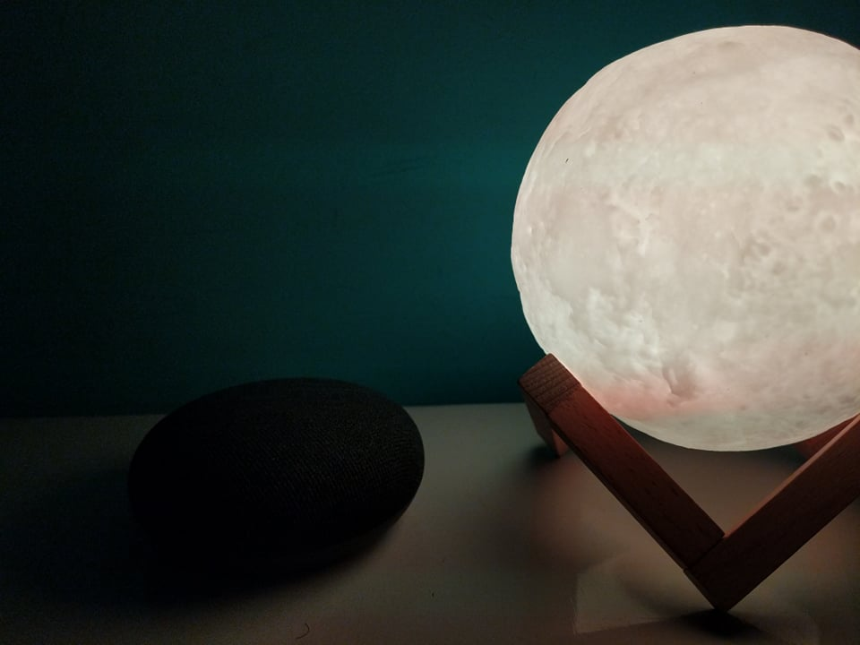
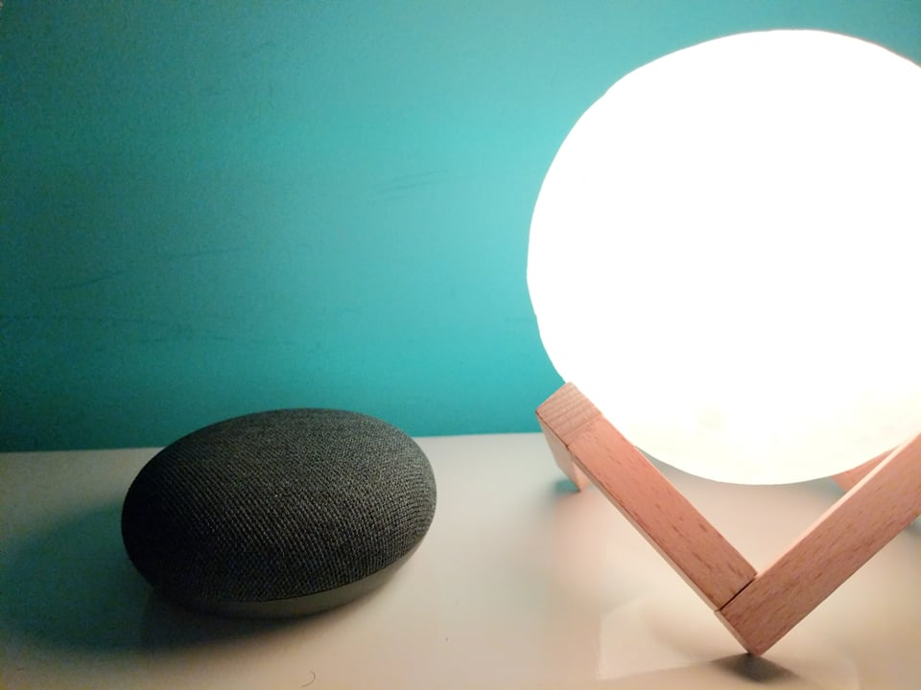
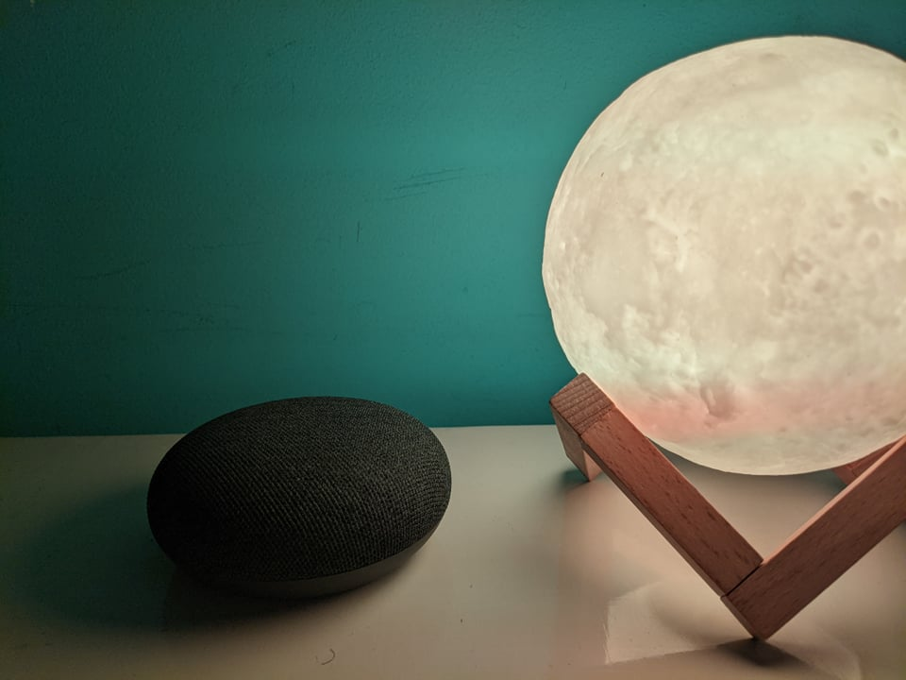
Digital Image Acquisition
Image Formation Model
Clipped at L_{min}
Clipped at L_{max} (saturated)
High Dynamic Range
Low Dynamic Range

Slide 28
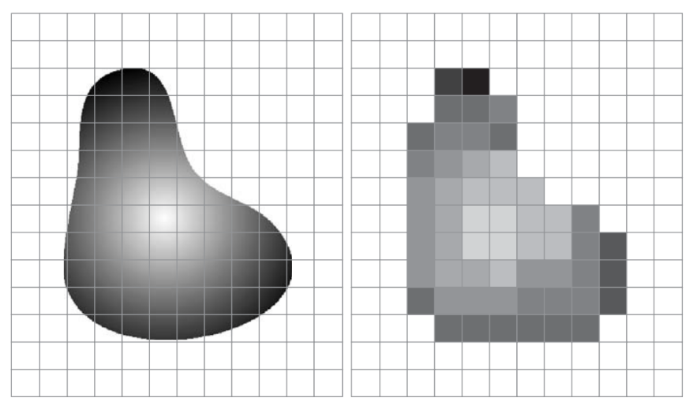
Digital Image Acquisition
Digitization
Two steps required:
Sampling
Quantization
By Rafael C. Gonzalez & Richard E. Woods, 2018, Digital Image Processing, 4th Edition

Slide 29
Digital Image Acquisition
Digitization
Two steps required:
Sampling
Quantization
By Rafael C. Gonzalez & Richard E. Woods, 2018, Digital Image Processing, 4th Edition

Slide 30
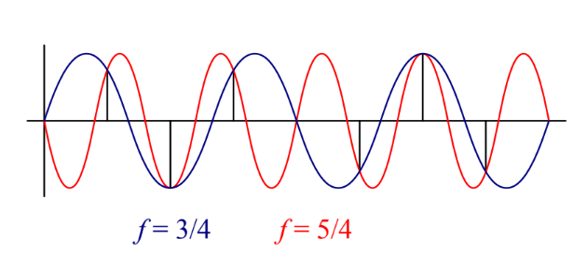
Digital Image Acquisition
Sampling and Aliasing in 1D
Aliasing of a one-dimensional signal:
The blue sine wave at f = 3/4 and the red sine wave at f = 5/4 have the same digital samples, when sampled at f = 2
These two signals are said to be “aliased”
We are now no longer able to reconstruct the original signal
Shannon’s Sampling Theorem: the minimum sampling rate required to reconstruct a signal from its instantaneous samples must be at least twice the highest frequency: f_{s} ≥ 2*f_{max}

Slide 31
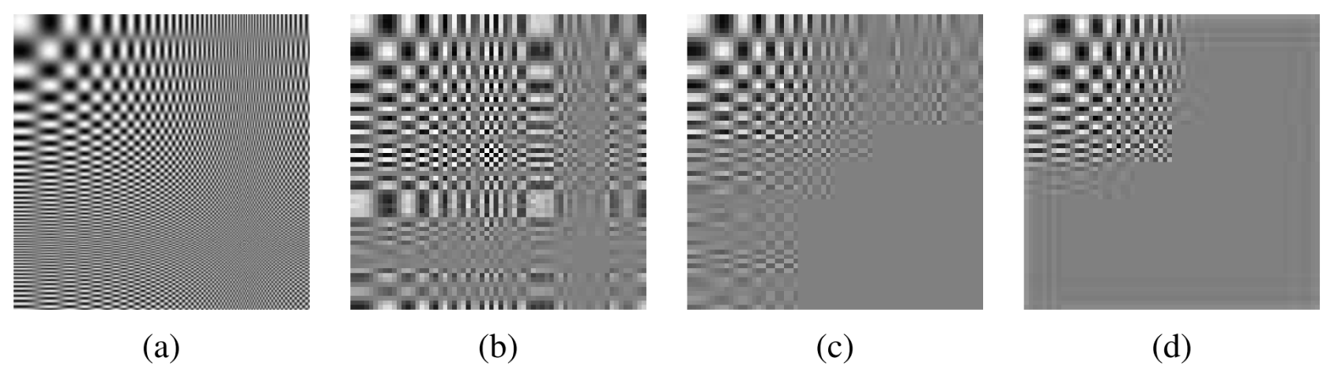
Digital Image Acquisition
Sampling and Aliasing in 2D
Notice how the higher frequencies are aliased into visible frequencies with the lower quality filters, while the 9-tap filter completely removes these higher frequencies. (Anti-aliasing filter)
Aliasing of a two-dimensional signal:
(a) original full-resolution image
(b) downsampled 4 × with a 25% fill factor box filter
(c) downsampled 4 × with a 100% fill factor box filter
(d) downsampled 4 × with a high-quality 9-tap filter

Slide 32
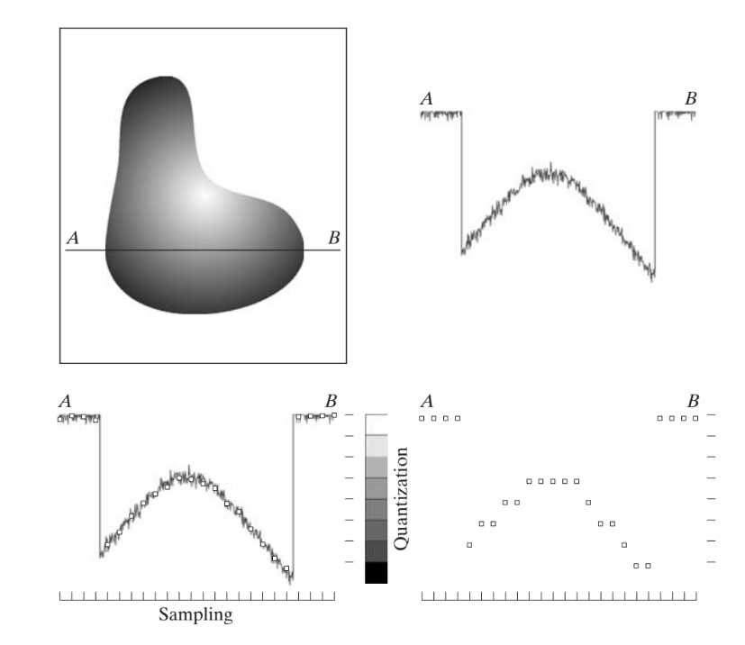
Digital Image Acquisition
Digitization
1) Image ➡
➡ 2) Scan line
3) Sampling ➡
➡ 4) Quantization
By Rafael C. Gonzalez & Richard E. Woods, 2018, Digital Image Processing, 4th Edition

Slide 33
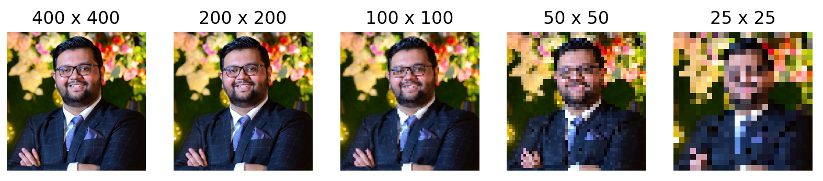
Digital Image Acquisition
Effect of Sampling

Slide 34




Digital Image Acquisition
Effect of Quantization
256 levels | 128 levels
64 levels | 32 levels

Slide 35
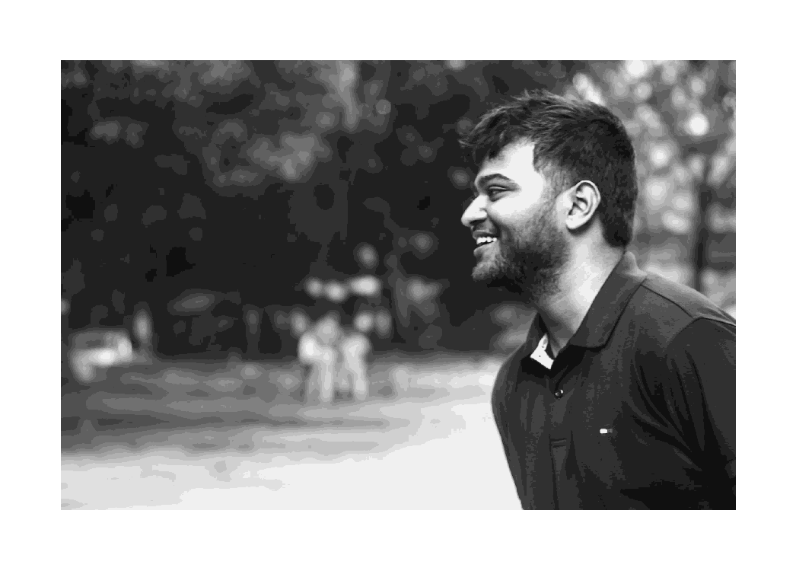
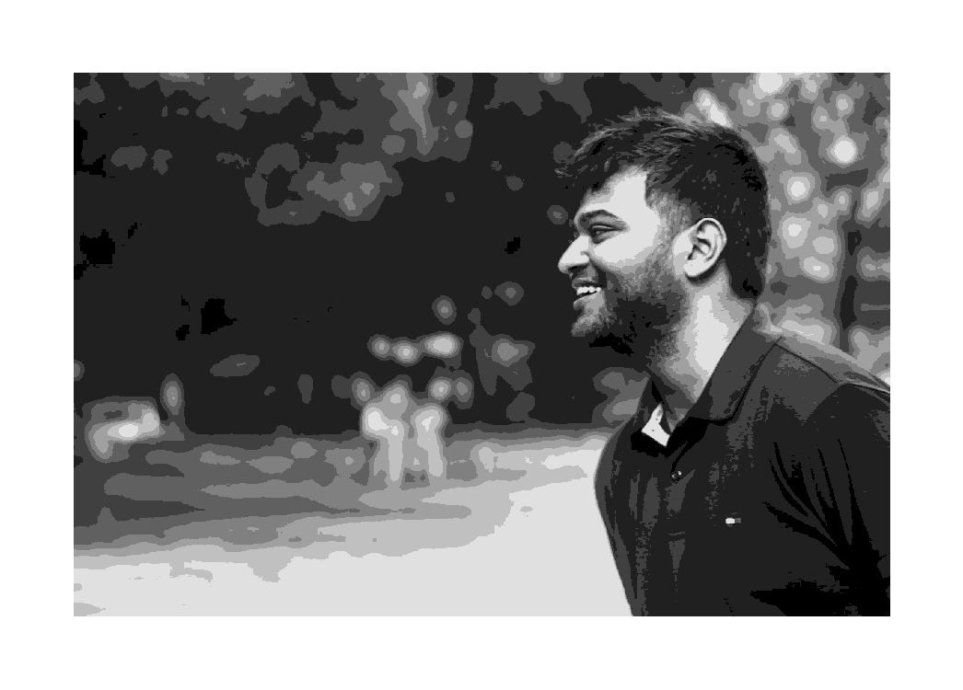
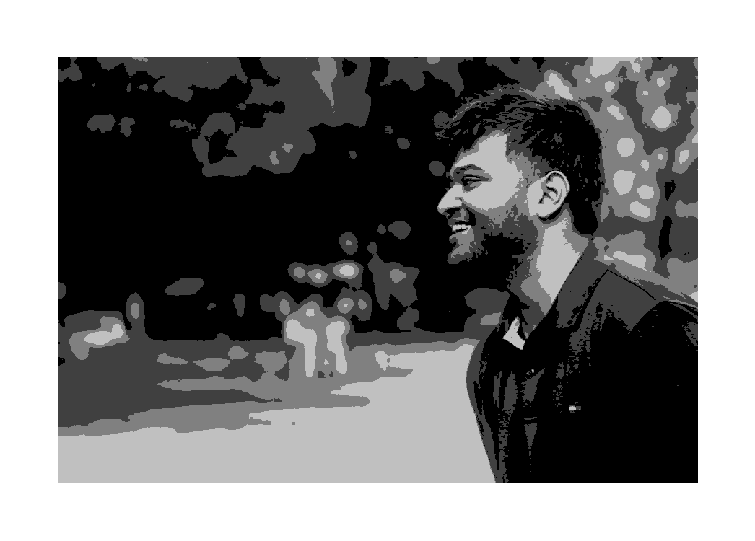
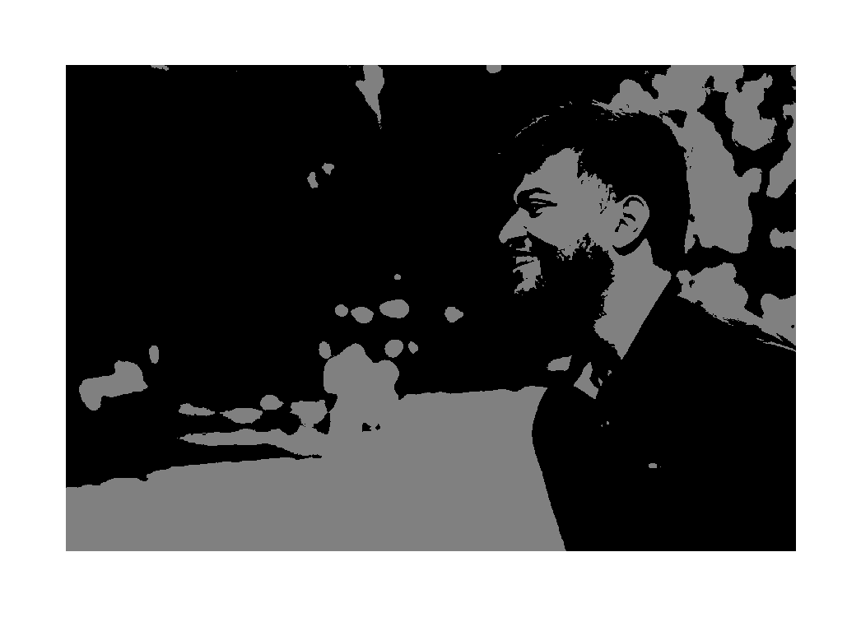
Digital Image Acquisition
Effect of Quantization
16 levels | 8 levels
4 levels | 2 levels (binary)
False contouring

Slide 36
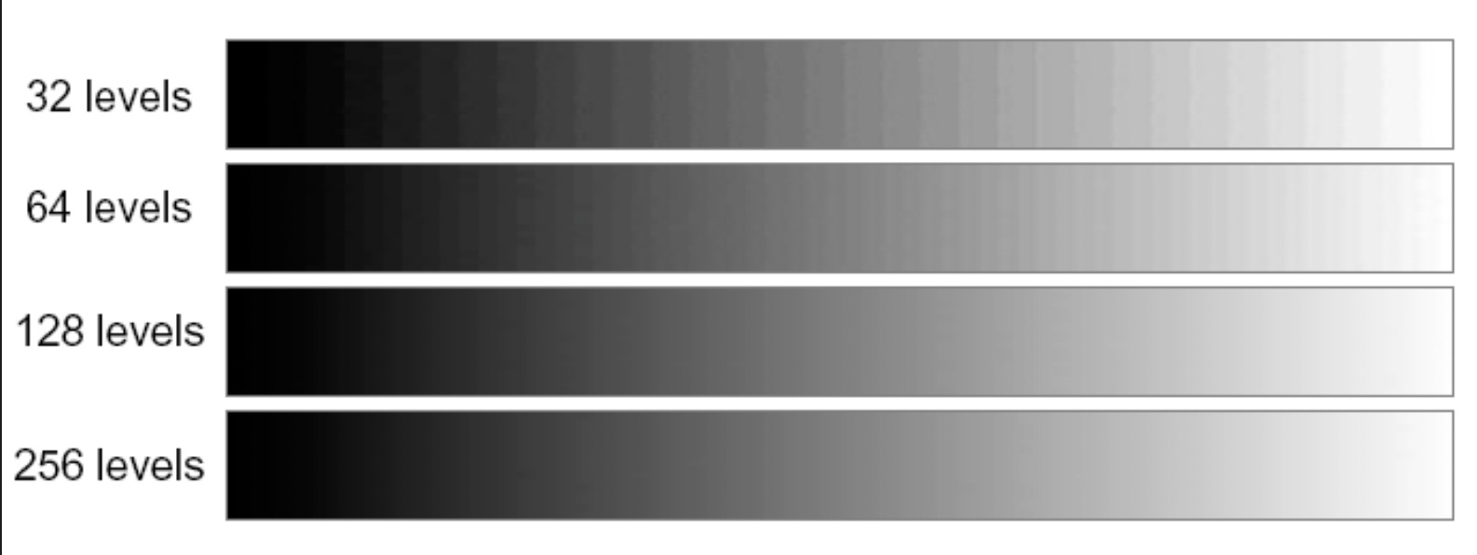
Digital Image Acquisition
Effect of Quantization
By Rafael C. Gonzalez & Richard E. Woods, 2018, Digital Image Processing, 4th Edition

Slide 37
Questions?

